Slide 1
Convolutional Neural Networks: historical, residual, and Inception networks… Also, transfer learning
Luke

Slide 2
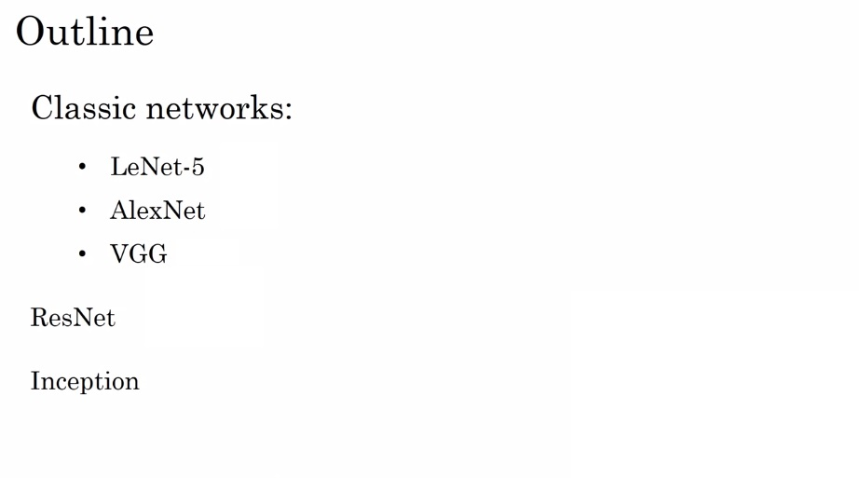
How do computers see?

Slide 3
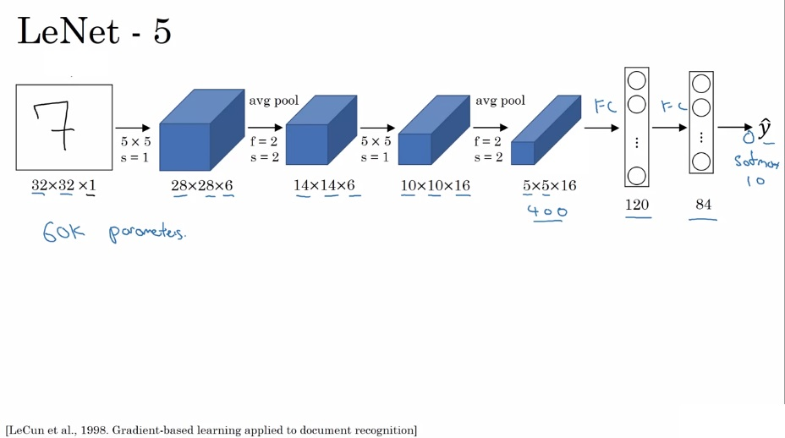
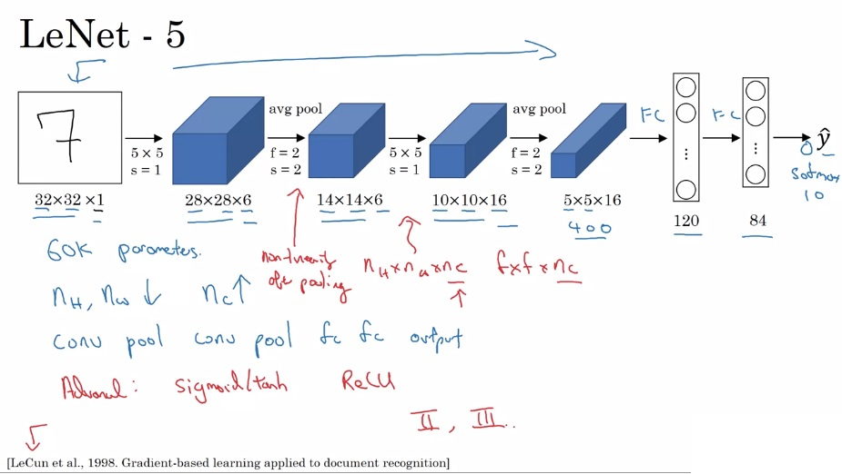
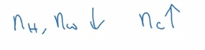
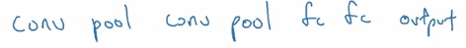
The first cnn
Back in the day, people only used valid convolutions, hence the dimension shrinking

Slide 4
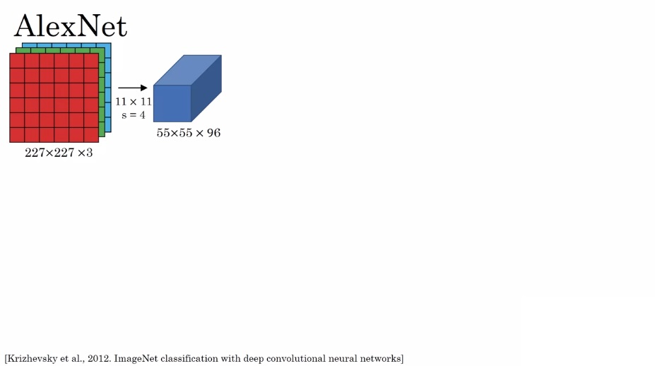
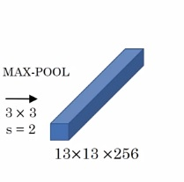
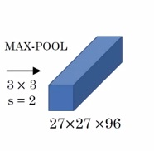
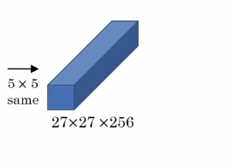
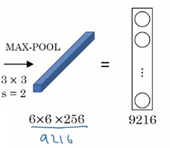
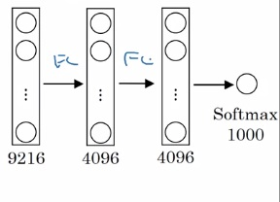
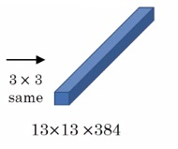
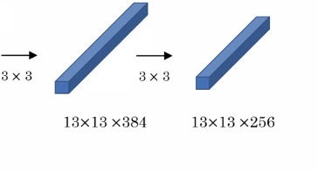
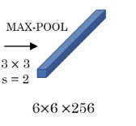
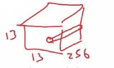
The network that changed computer vision
Heavily inspired by LeNet 5, but much bigger ~ 60M parameters
Also, used Relu
Advanced: Multiple GPUS Local Response Normalization

Slide 5
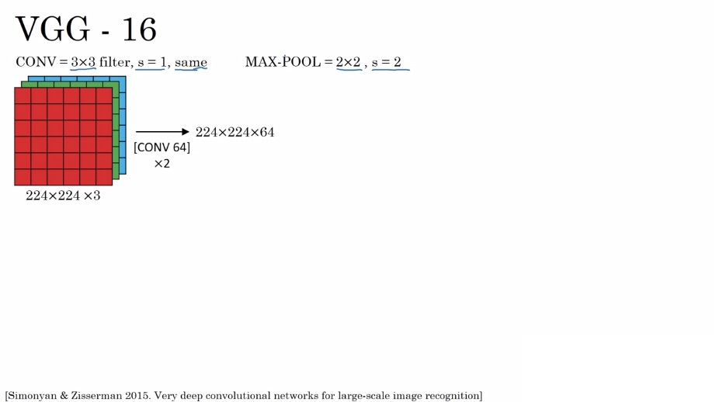
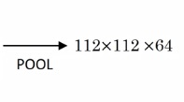
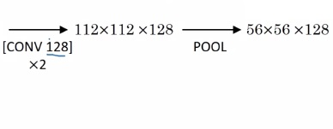
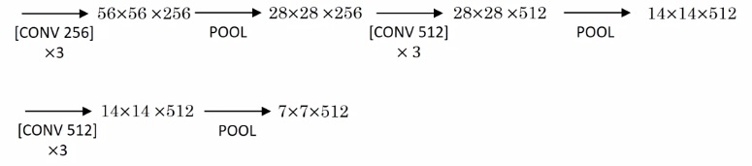
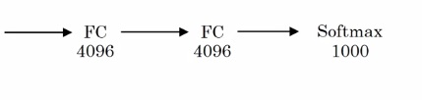
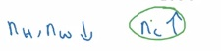
“standardized” cnns
138,000,000 parameters
Daddy of VGG-19
Nc going up by a factor of 2, up to 512

Slide 6
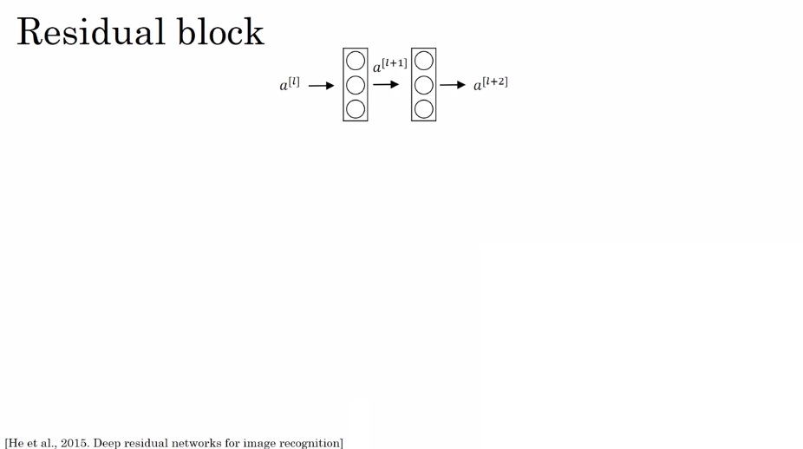
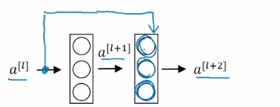
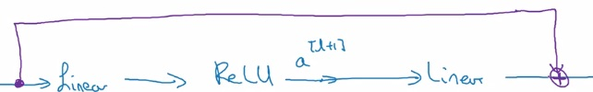
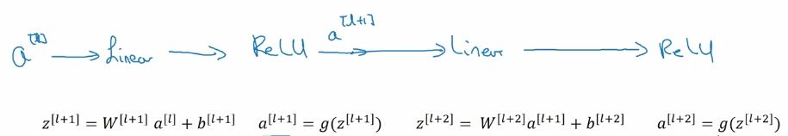
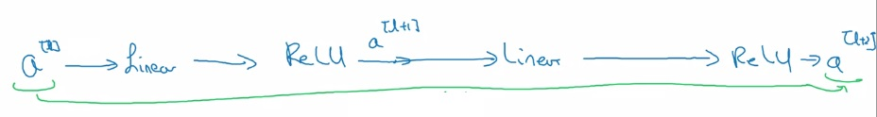
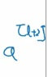
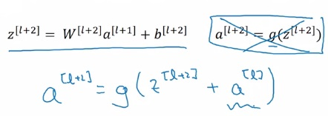
Resnets – Alphafold is 2 resnets!
“short cut” OR “skip connection”
“main path”

Slide 7
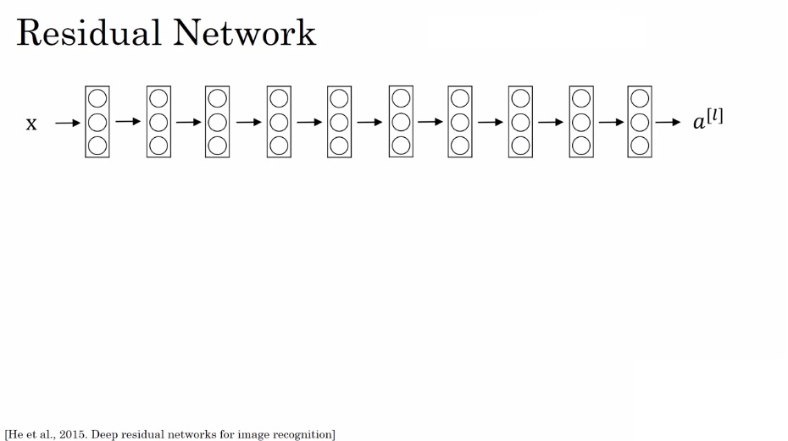
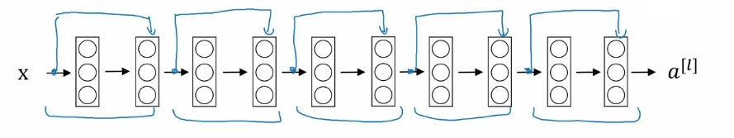
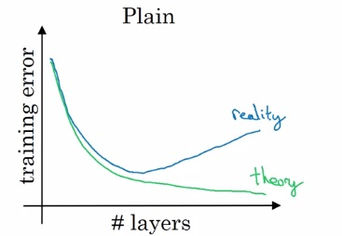
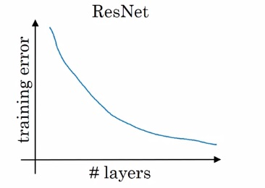
resnets
“plain network”
Why?

Slide 8
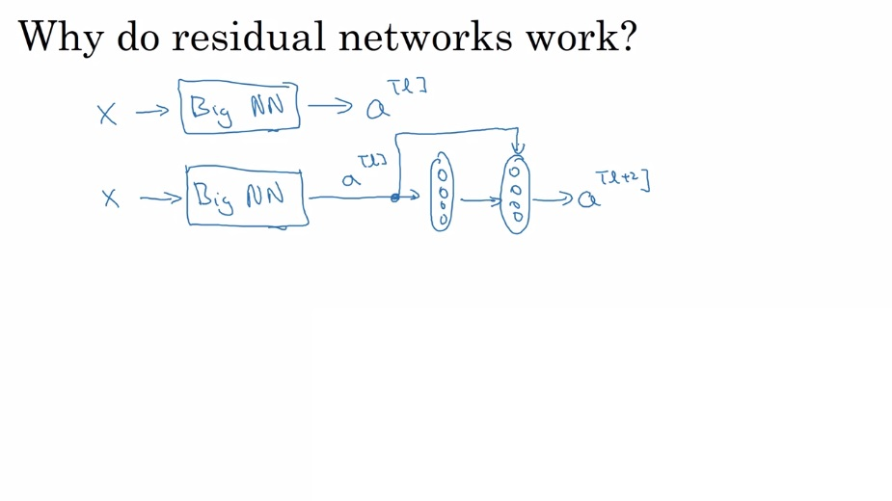

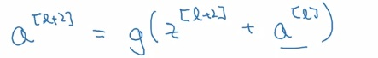
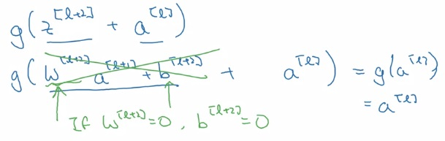
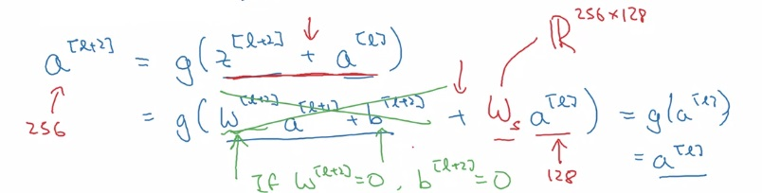
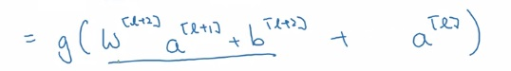
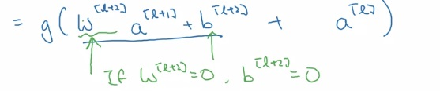
Residual network intuition
If we’re using L2 regularization, we’re shrinking
the parameters asymptotically close to zero
“same” convolutions
used a lot in Resnets for to keep
dimensions consistent
Easy for a residual block to learn
the identity function. So in the case of Res nets,
adding layers shouldn’t hurt
performance
New W could be
a matrix of learnable
parameters or a matrix
that implements
“zero-padding”

Slide 9
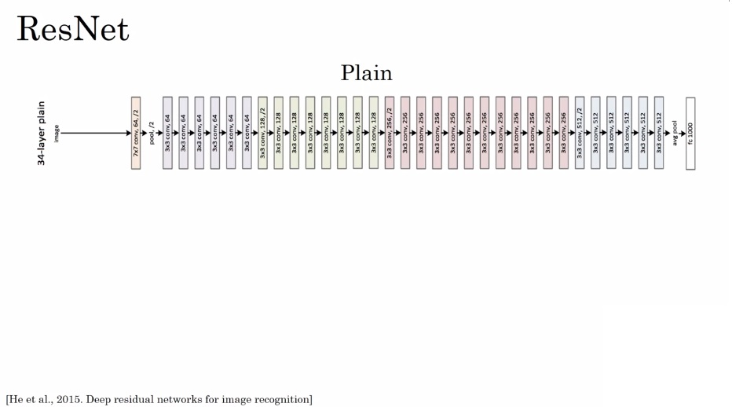
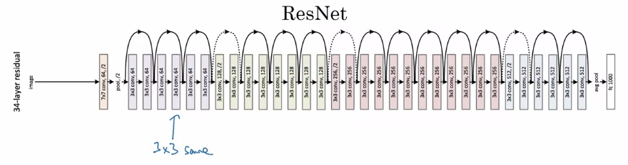
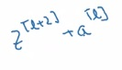
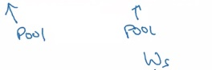
How do computers see?

Slide 10
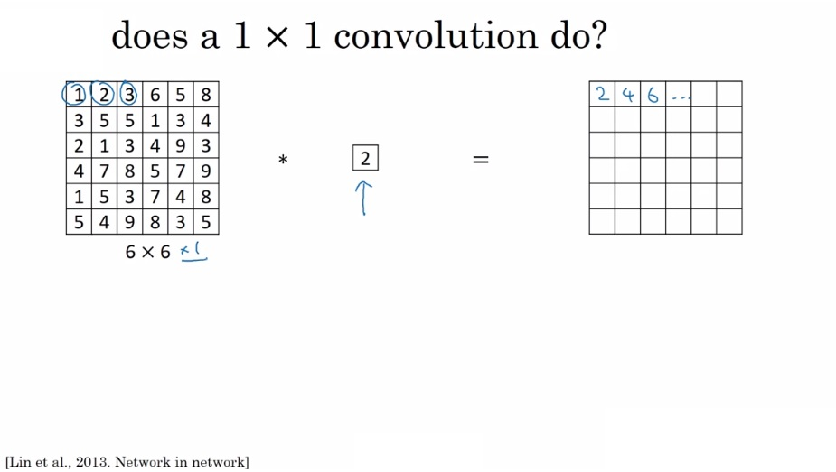
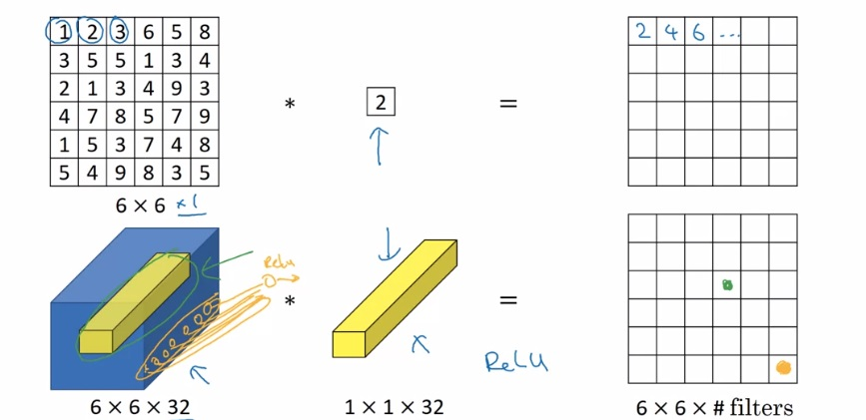
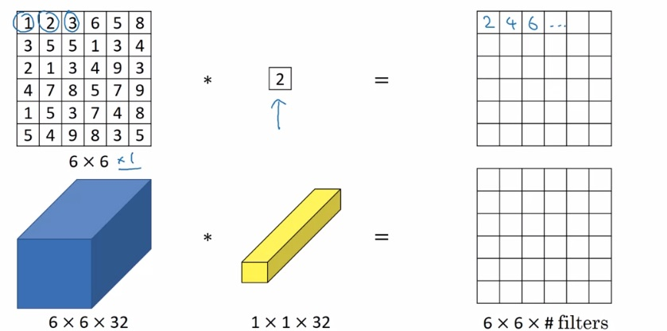
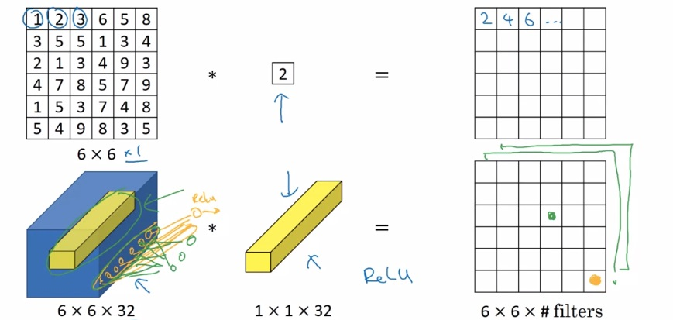
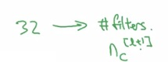
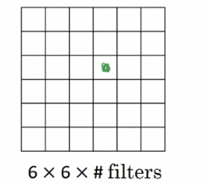
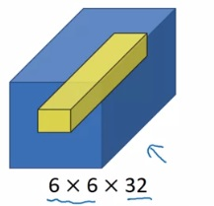
Convolving 1 x 1
What
Element-wise
product then
apply relu

Slide 11
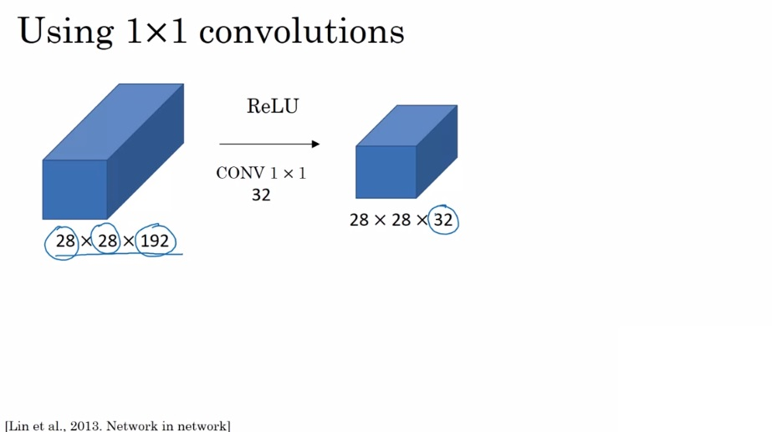



Why 1x1

Slide 12



We gotta go deeper

Slide 13




It ain’t cheap going deep

Slide 14


1x1 to the rescue
“bottleneck layer”
28 x 28 x 32 x 5 x 5 x 16 = 10,000,000
28 x 28 x 16 x 192 = 2,400,000
Grand total: 12,400,000 < 120,000,000

Slide 15






How do we go deeper?

Slide 16





Stacking modules, baby
GooLeNet

Slide 17
Open source implementations
https://github.com/llSourcell/DeepMind-alphafold-repl

Slide 18







using someone else’s weights
trainableParameter = 0 freeze= 1
Little own data
train
Lots of own data
Massive amount of own data

Slide 19







Data augmentation

Slide 20





State of computer vision

Slide 21


How to get a cnn published
3 – 15 networks. Good in academia, bad for production
Common in both academia and production

Slide 22
Transfer learning

Slide 23
Open source implementations
https://github.com/llSourcell/DeepMind-alphafold-repl

Slide 24


Coarse to fine sampling scheme

